Slide 1



Noida Institute of Engineering and Technology, Greater Noida
Blockchain Hyperledger Fabric
UNIT 5
Unit: 5
BLOCKCHAIN TECHNOLOGY AND
APPLICATION DEVELOPMENT (ACSAI0601)
Mr. Yaduvir Singh Assistant Professor
B.Tech AI
Course Details (B Tech 6th Sem)

Slide 2

Noida Institute of Engineering and Technology, Greater Noida
YADUVIR SINGH
BE and M.Tech in CSE with 15 Years Teaching Experience
Area of Expertise:AI ,Data Science,Block Chain
Membership:MISTE(lifetime),MIAENG,MIFERP,MCSTA ,MIRED.
Received Best Faculty Award in SIET Ghaziabad in October 2008.
Act as an External Judge for the 25th National Children Science Congress a Program by DST India at Kendriya Vidyalaya Greater Noida From 23 to 25 October 2017.
Attended and Conducted Numerous National Level Workshops.
Published about 20 National and International Papers in reputed Journals.
Going to finish my MSWC(Master of Social Work in Counselling)through IGNOU by 2021.

Slide 3
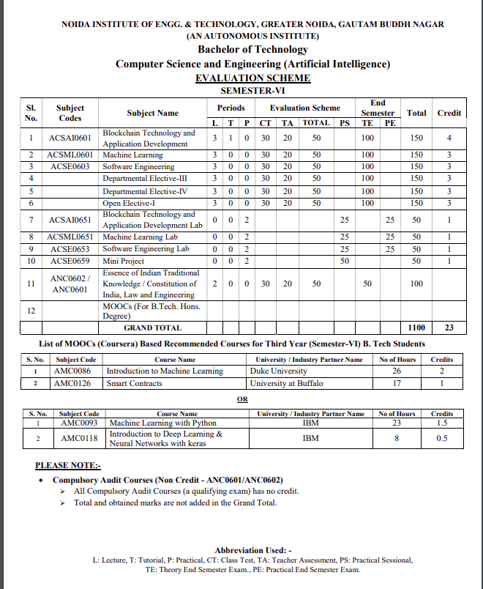
Noida Institute of Engineering and Technology, Greater Noida

Slide 4
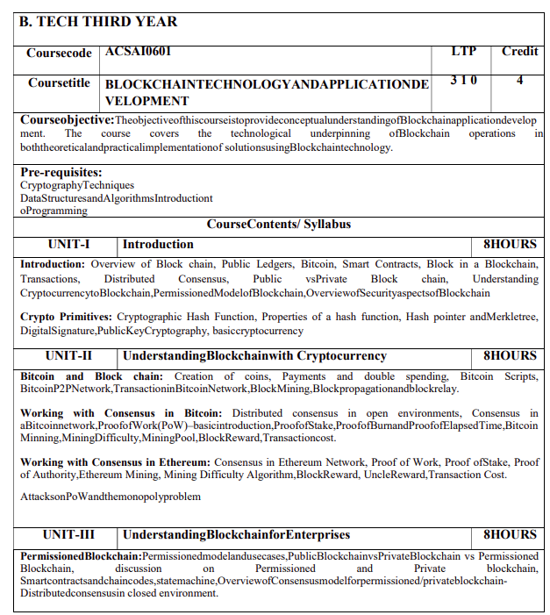
Noida Institute of Engineering and Technology, Greater Noida
Syllabus

Slide 5
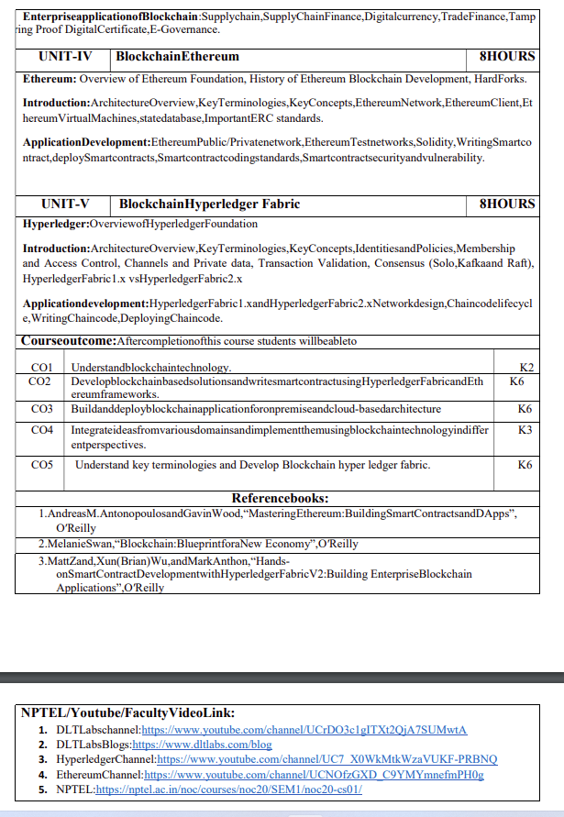
Noida Institute of Engineering and Technology, Greater Noida
Syllabus

Slide 6
Branch Wise Applications
It can compute man-made problems as well as natural phenomena. Block Chain theory has a lot of applications in real life as well, such that in SCM,education ,security ,banking and many fields.

Slide 7
Course Objective
To assess blockchain applications in a structured manner.
To impart knowledge in block chain techniques and able to present the concepts clearly and structured.
To get familiarity with future currencies and to create own crypto token.

Slide 8
Course Outcome
Course Outcome (CO) |  | Bloom’s Knowledge Level (KL)
At the end of the course, the student will be able to understand
CO 1 | Understand block chain technology. |  | K2
CO 2 | Develop block chain based solutions and write smart contract using Hyper ledger Fabric and Ethereum frameworks. |  | K6
CO 3 | Buildanddeployblockchainapplicationforonpremiseandcloud-basedarchitecture |  | K6
CO 4 | Integrate ideas from various domains and implement them using block chain technology in differ ent perspectives. |  | K3
CO 5 | Understand key terminologies and Develop Block chain hyper ledger fabric. |  | K6

Slide 9
Program Outcomes
Engineering Graduates will be able to Understand:
1. Engineering knowledge
2. Problem analysis
3. Design/development of solutions
4. Conduct investigations of complex
5. Modern tool usage
6. The engineer and society
7. Environment and sustainability
8. Ethics
9. Individual and team work
10. Communication
11. Project management and finance
12. Life-long learning

Slide 10
CO-PO and PSO Mapping
CO-PO correlation matrix of Block Chain and Application Development(ACSAI0601)
 | PO1 | PO2 | PO3 | PO4 | PO5 | PO6 | PO7 | PO8 | PO9 | PO10 | PO11 | PO12
ACSAI0601 | 2 | 2 | 3 | 3 | 2 | 2 | - | - | 2 | 1 | - | 3
ACSAI0601 | 1 | 3 | 2 | 3 | 2 | 2 | - | 1 | 1 | 1 | 2 | 2
ACSAI0601 | 2 | 2 | 3 | 2 | 2 | 2 | - | 2 | 2 | 1 | 2 | 3
ACSAI0601 | 2 | 2 | 2 | 3 | 2 | 2 | - | 2 | 2 | 1 | 1 | 3
ACSAI0601 | 3 | 2 | 2 | 2 | 2 | 2 | - | 2 | 1 | 1 | 1 | 2
Average | 2 | 2.2 | 2.4 | 2.6 | 2 | 2 | - | 1.4 | 1.6 | 1 | 1.2 | 2.6
Mapping of Program Specific Outcomes and Course Outcomes:

Slide 11
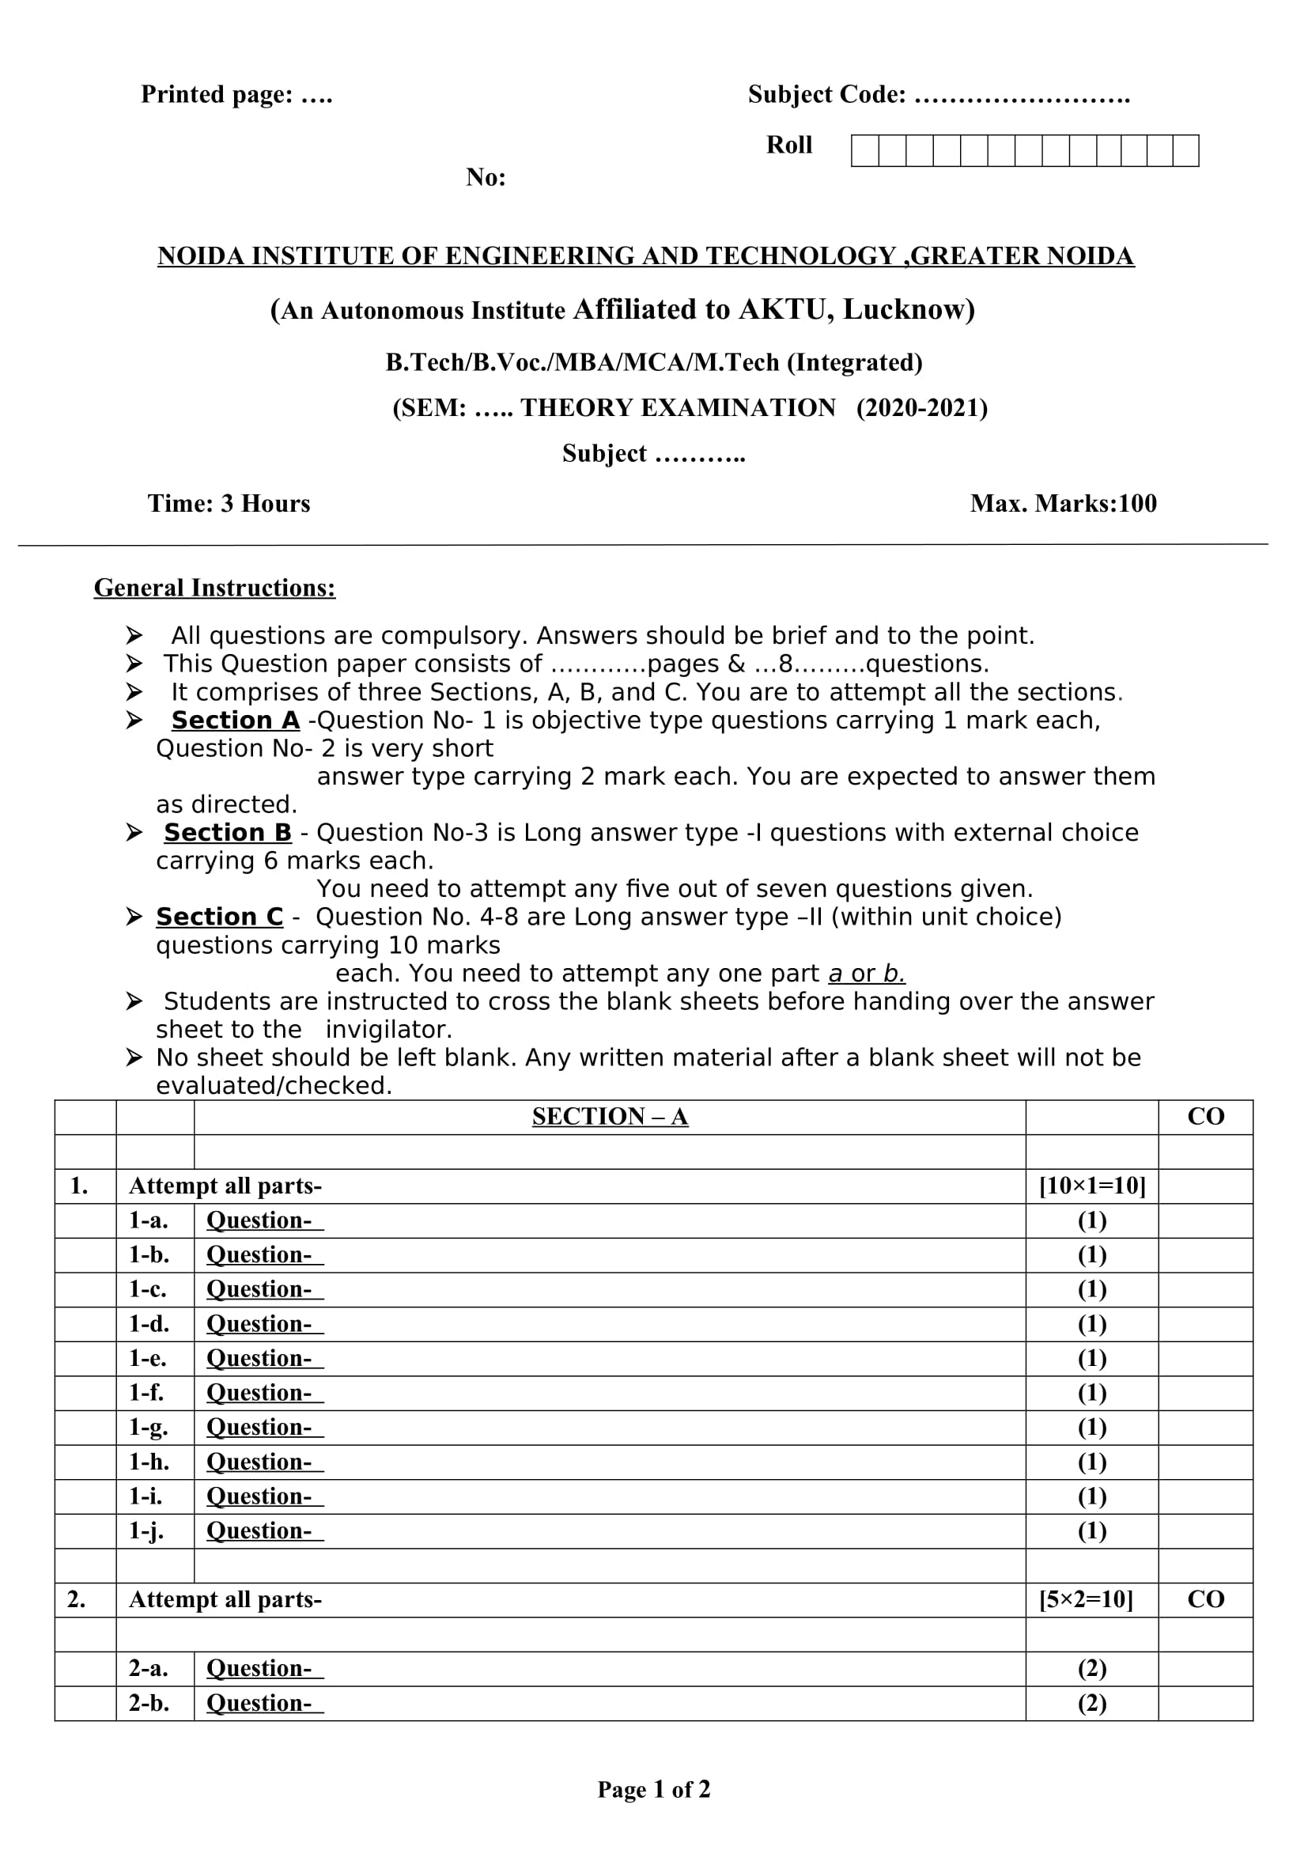
End Semester Question Paper Templates (Offline Pattern/Online Pattern)
End Semester Question Paper Templates (Offline Pattern/Online Pattern)

Slide 12
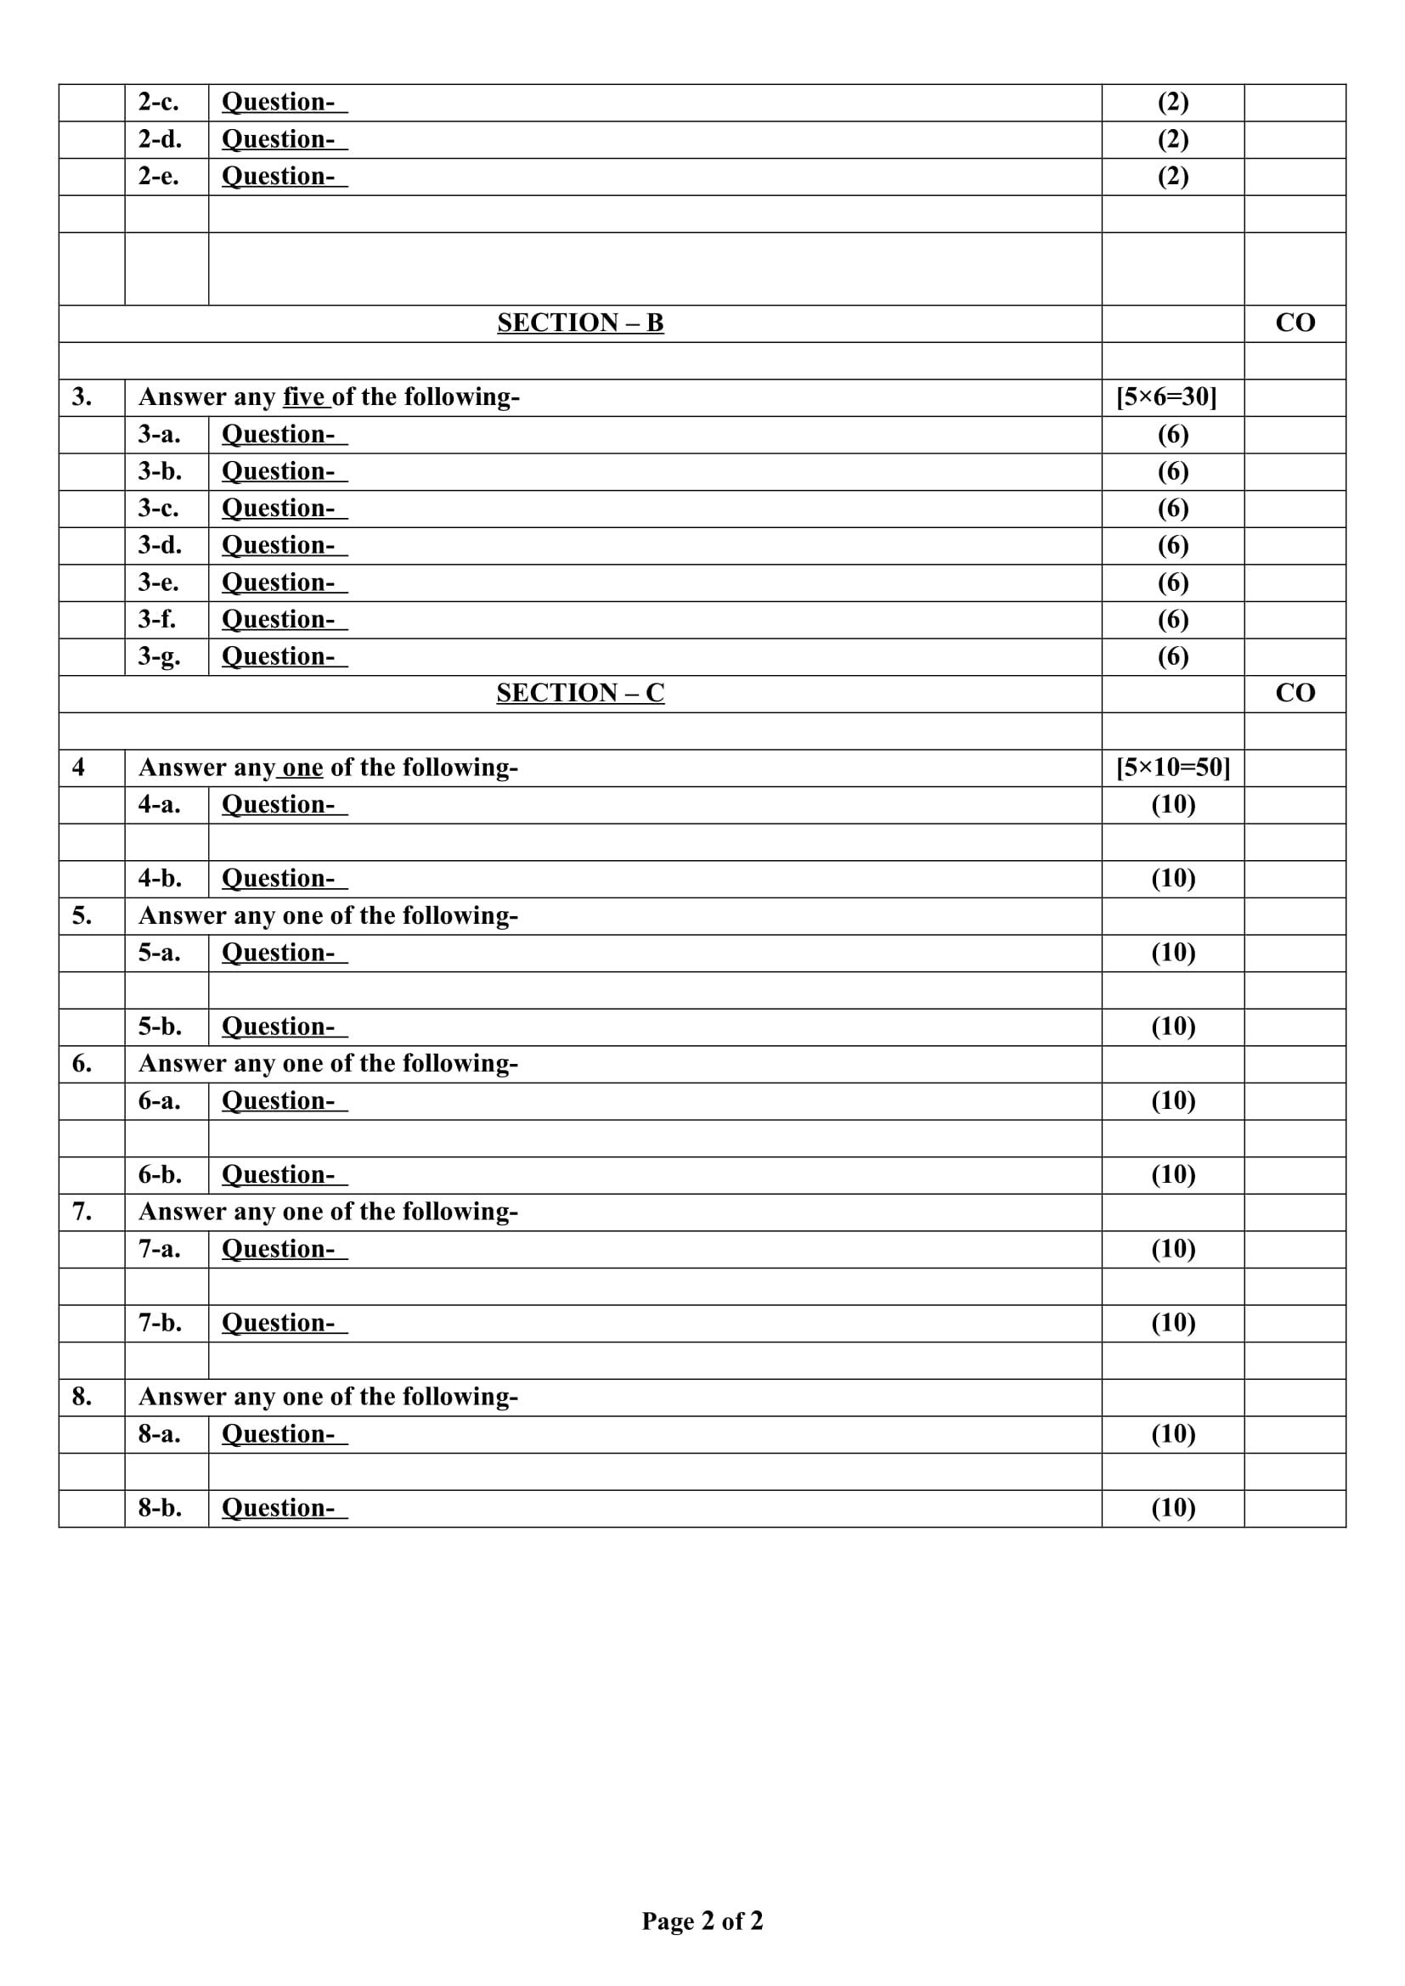
End Semester Question Paper Templates (Offline Pattern/Online Pattern)

Slide 13
Prerequisite and Recap
Brief input about the block chain and its introduction in the different fields. The basics of the Cyber security and cryptography are the requirements of this course.

Slide 14
Brief Introduction about the Subject with videos
Blockchain is a buzzword in today’s technology and this technology is described as the most disruptive technology of the decade.
Thus, Blockchain is used for the secure transference of items like money, contracts, property rights, stocks, and even networks without any requirement of Third Party Intermediaries like Governments, banks, etc.
DLTLabschannel:https://www.youtube.com/channel/UCrDO3c1gITXt2QjA7SUMwtA
DLTLabsBlogs:https://www.dltlabs.com/blog
HyperledgerChannel:https://www.youtube.com/channel/UC7_X0WkMtkWzaVUKF-PRBNQ
EthereumChannel:https://www.youtube.com/channel/UCNOfzGXD_C9YMYmnefmPH0g
NPTEL:https://nptel.ac.in/noc/courses/noc20/SEM1/noc20-cs01/

Slide 15
Content
Overview of Hyperledger Foundation
Architecture Overview of Hyperledger Foundation
Why Fabric 2.x is much better than Fabric 1.x
Fabric chaincode lifecycle

Slide 16
Topic Objectives
The objective of this topic is to provide conceptual understanding of Hyperledger Fabric, architecture-based framework for distributed ledger applications, high levels of privacy, robustness, customization, and scalability.

Slide 17
Unit V Syllabus
Hyperledger: Overview of Hyperledger Foundation
Introduction: ArchitectureOverview,KeyTerminologies,KeyConcepts,IdentitiesandPolicies,Membership and Access Control, Channels and Private data, Transaction Validation, Consensus (Solo,Kafkaand Raft), HyperledgerFabric1.x vsHyperledgerFabric2.x
Application development:
HyperledgerFabric1.x and HyperledgerFabric2.x Network design, Chain code life cycle, Writing Chain code, Deploying Chain code.

Slide 18
Overview of Hyperledger Foundation(CO5)
Hyperledger Foundation is an open source community focused on developing a suite of stable frameworks, tools and libraries for enterprise-grade blockchain deployments. It is a global collaboration, hosted by The Linux Foundation, and includes leaders in finance, banking, Internet of Things, supply chains, manufacturing and Technology. Built under technical governance and open collaboration, individual developers, service and solution providers, government associations, corporate members and end users are all invited to participate in the development and promotion of these game-changing technologies.
As part of the The Linux Foundation, Hyperledger Foundation has a modular approach to hosting projects. The Hyperledger Foundation hosts developing business blockchain projects from Hyperledger Labs to stable code ready for production. All are invited to contribute to Hyperledger projects and communities; collectively advancing industry goals of distributed ledger and smart contracts.

Slide 19
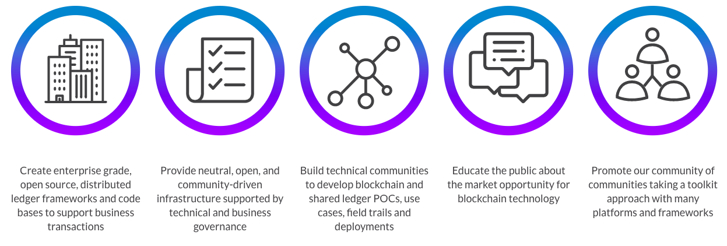
Overview of Hyperledger Foundation(CO5)
Hyperledger Foundation Goals

Slide 20
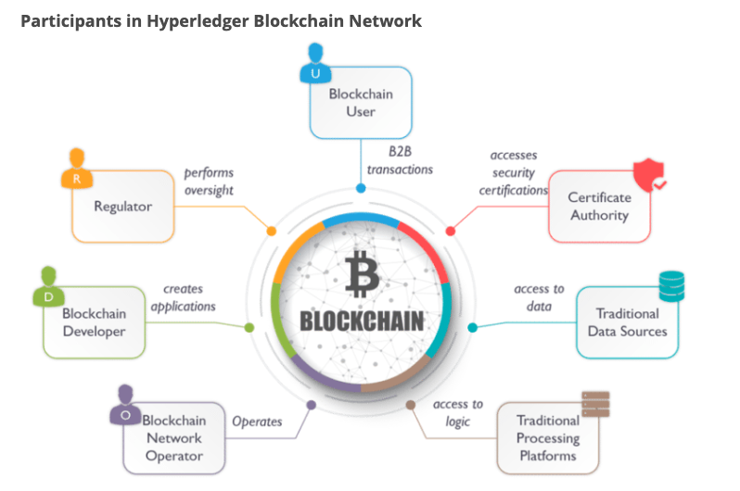
Architecture Overview of Hyperledger Foundation(CO5)
Hyperledger Fabric is an open-source platform for building distributed ledger solutions, with a modular architecture that delivers high degrees of confidentiality, flexibility, resiliency, and scalability. This enables solutions developed with fabric to be adapted for any industry.

Slide 21
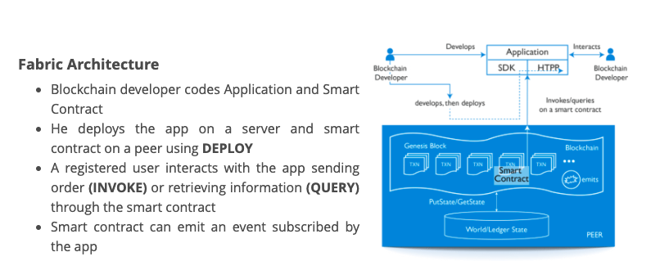
Architecture Overview of Hyperledger Foundation(CO5)

Slide 22
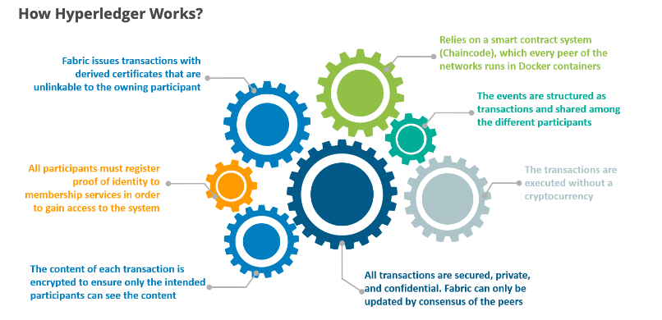
Architecture Overview of Hyperledger Foundation(CO5)

Slide 23
Architecture Overview of Hyperledger Foundation(CO5)
Hyperledger Fabric was designed to be a truly modular, scalable and secure foundation for industrial Blockchain solutions. Maybe the most notable change in the upgrade from Fabric version0.6 to Fabric 1.0 is that the peers are now decoupled into two separate runtimes with three distinct roles.
Types of Peers
Committer peer: Commits transactions, maintains ledger and state
Endorsing peer: Receives a transaction proposal for endorsement, responds granting or denying endorsement
Ordering peer: Approves the inclusion of transaction blocks into the ledger and communicates with peer and endorsing peer nodes

Slide 24
Architecture Overview of Hyperledger Foundation(CO5)
Components of Hyperledger Foundation
Hyperledger fabric is an enterprise-level permission blockchain network. It is made up of various unique organizations or members that interact with each other to serve a specific purpose. For example, these organizations can be a bank, financial institution, or a supply chain network. Each organization is identified and they have a fabric certificate authority. These organizations are called members.
Each member of the fabric can set up one or more authorized peers to participate in the network using the fabric certificate authority. All of these peers must be authorized properly.
There is a client-side application connected to the network written with the software development kit (SDK) of any particular programming language.

Slide 25
Architecture Overview of Hyperledger Foundation(CO5)
Workflow of Hyperledger Foundation
For each and every transaction in the fabric, the following steps are followed-
Creation of the proposal: Imagine a deal between a smartphone manufacturer company and a smartphone dealership. The transaction begins when a member organization proposes or invokes a transaction request with the help of the client application or portal. Then the client application sends the proposal to peers in each organization for endorsement.
Endorsement of the transaction: After the proposal reaches the endorser peers (peers in each organization for endorsement of a proposal) the peer checks the fabric certificate authority of the requesting member and other details that are needed no authenticate the transaction. Then it executes the chain code (a piece of code that is written in one of the supported languages such as Go or Java) and returns a response. This response indicates the approval or rejection of the following transaction. The response is carried out to the client.
Submission to ordering service: After receiving the endorsement output, the approved transactions are sent to the ordering service by the client-side application. The peer responsible for the ordering service includes the transaction into a specific block and sends it to the peer nodes of different members of the network
Updating the ledger: After receiving this block the peer nodes of such organizations update their local ledger with this block. Hence the new transactions are now committed.

Slide 26
Architecture Overview of Hyperledger Foundation(CO5)
Benefits Of Hyperledger Fabric
1. Open Source:
2. Private and Confidential:
3. Access Control:
4. Chaincode Functionality:
5. Performance:

Slide 27
Architecture Overview of Hyperledger Foundation(CO5)
Hyperledger Fabric 2.0: What’s New?
The first-ever Hyperledger Fabric release was back in v1.0. And now, we have the second major Hyperledger Fabric 2.0 release. This time it does come with a lot of new and improved features for both users and operators in the platform.
Hyperledger Fabric 2.0 release includes privacy patterns and supports new applications, new features for operating nodes, enhanced governance systems for smart contracts, and many more.
However, they won’t force you to upgrade to the latest Hyperledger Fabric 2.0 if you are not ready yet. So, you have the option to upgrade when you are ready, or your company is ready for the transition.

Slide 28
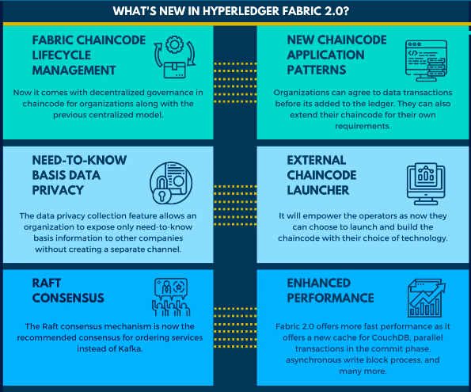
Architecture Overview of Hyperledger Foundation(CO5)
Why Fabric 2.x is much better than Fabric 1.x?

Slide 29
Architecture Overview of Hyperledger Foundation(CO5)
Some of the highlights of the new release
Smart Contracts Decentralized Governance
Agreement to The Parameters of Chaincode
Cautious Chaincode Upgrades
Private Data Collection and Easy Endorsement Policy Updates
Inspectable Chaincode Packages
Multiple Chaincodes On A Channel
Chaincode Packages Across Channel Members
Using the New Chaincode Lifecycle
New Chaincode Application Patterns
Automated Checks
Decentralized Agreement
Capabilities
Private Data Enhancements

Slide 30
Architecture Overview of Hyperledger Foundation(CO5)
What Is Private Data?
In many cases, an enterprise may need to keep certain information private in a channel from other companies. Thus, they have to create a new channel with only the organizations that can see the information separately. But that means it will also need additional administrations, policies, membership accesses, and many more.
More so, it also doesn’t allow the channel participant to use the system in any use cases where all parties can see some part of information while others remain hidden.
However, now the Hyperledger Fabric 2.0 roadmap will help you create a private data collection. Here you can define a subset of companies that can see the private data without creating a new channel for every case.

Slide 31
Fabric chaincode lifecycle(CO5)
What is Chaincode?
Chaincode is a program, written in Go, Node.js, or Java that implements a prescribed interface. Chaincode runs in a secured Docker container isolated from the endorsing peer process. Chaincode initializes and manages ledger state through transactions submitted by applications.
A chaincode typically handles business logic agreed to by members of the network, so it may be considered as a “smart contract”. Ledger updates created by a chaincode are scoped exclusively to that chaincode and can’t be accessed directly by another chaincode. However, within the same network, given the appropriate permission a chaincode may invoke another chaincode to access its state.
In this concept topic, we will explore chaincode through the eyes of a blockchain network operator rather than an application developer. Chaincode operators can use this topic as a guide to how to use the Fabric chaincode lifecycle to deploy and manage chaincode on their network.

Slide 32
Fabric chaincode lifecycle(CO5)
Deploying a chaincode
The Fabric chaincode lifecycle is a process that allows multiple organizations to agree on how a chaincode will be operated before it can be used on a channel. A network operator would use the Fabric lifecycle to perform the following tasks:
Install and define a chaincode
Upgrade a chaincode
Deployment Scenarios
Migrate to the new Fabric lifecycle

Slide 33
Fabric chaincode lifecycle(CO5)
Install and define a chaincode
Fabric chaincode lifecycle requires that organizations agree to the parameters that define a chaincode, such as name, version, and the chaincode endorsement policy. Channel members come to agreement using the following four steps.
Package the chaincode: This step can be completed by one organization or by each organization.
Install the chaincode on your peers: Every organization that will use the chaincode to endorse a transaction or query the ledger needs to complete this step.
Approve a chaincode definition for your organization: Every organization that will use the chaincode needs to complete this step. The chaincode definition needs to be approved by a sufficient number of organizations to satisfy the channel’s LifecycleEndorsment policy (a majority, by default) before the chaincode can be started on the channel.
Commit the chaincode definition to the channel: The commit transaction needs to be submitted by one organization once the required number of organizations on the channel have approved. The submitter first collects endorsements from enough peers of the organizations that have approved, and then submits the transaction to commit the chaincode definition.

Slide 34
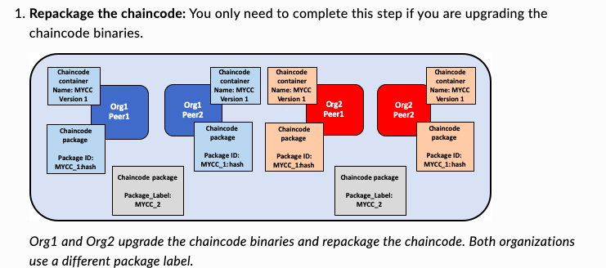
Fabric chaincode lifecycle(CO5)
Upgrade a chaincode

Slide 35
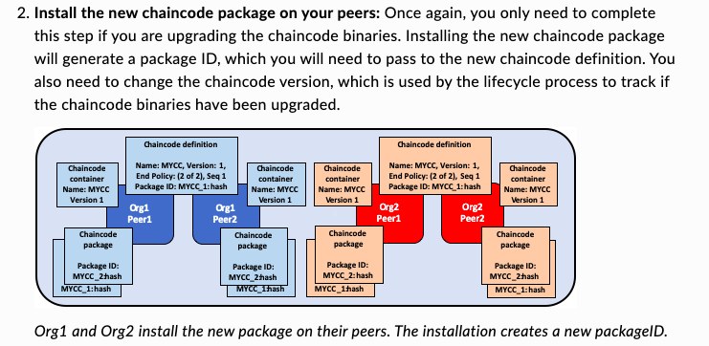
Fabric chaincode lifecycle(CO5)
Upgrade a chaincode

Slide 36
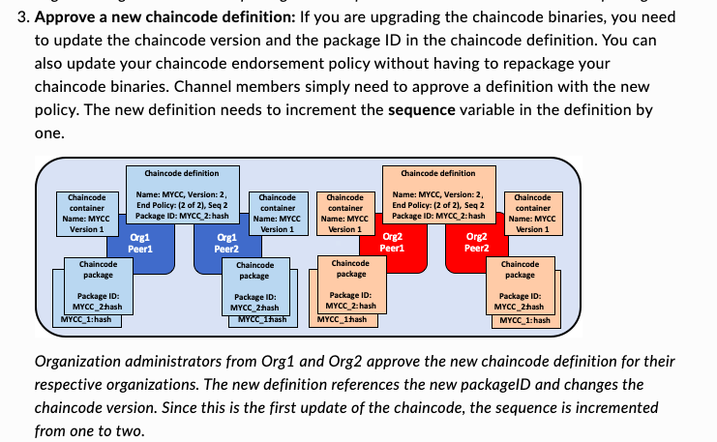
Fabric chaincode lifecycle(CO5)
Upgrade a chaincode

Slide 37
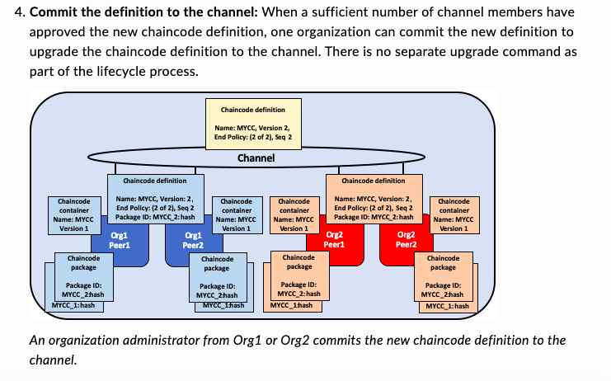
Fabric chaincode lifecycle(CO5)
Upgrade a chaincode

Slide 38
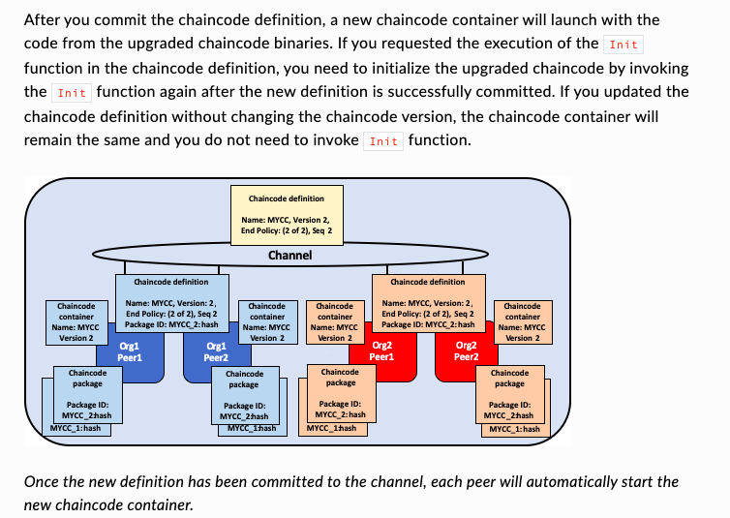
Fabric chaincode lifecycle(CO5)
Upgrade a chaincode

Slide 39
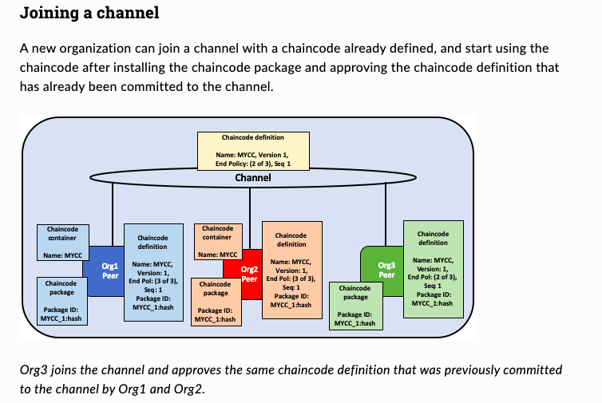
Fabric chaincode lifecycle(CO5)
Deployment scenarios
The following examples illustrate how you can use the Fabric chaincode lifecycle to manage channels and chaincode.

Slide 40
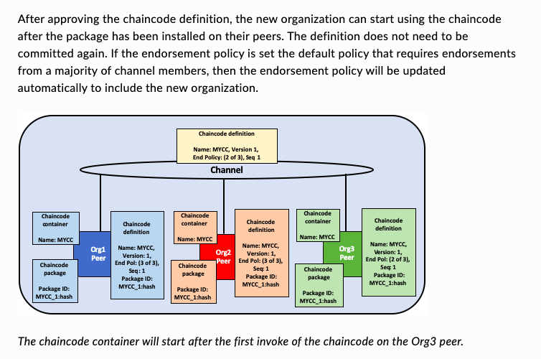
Fabric chaincode lifecycle(CO5)
Deployment scenarios

Slide 41
Fabric chaincode lifecycle(CO5)
Writing Chain Code
Every chaincode program must implement the Chaincode interface whose methods are called in response to received transactions.
The Init method is called when a chaincode receives an instantiate or upgrade transaction. So that the chaincode may perform any necessary initialisation, including initialisation of application state.
The Invoke method is called in response to receiving an invoke transaction to process transaction proposals.

Slide 42
Fabric chaincode lifecycle(CO5)
Writing Chain Code
Step:
Step 1: Add the go import statements for the necessary dependencies for our chaincode.
Step 2: Initializing the Chaincode
Init is called during chaincode instantiation to initialise any data.
Step 3: Invoking the Chaincode
Invoke is called per transaction on the chaincode. Each transaction is either a ‘get’ or a ‘set’ on the asset created by Init function. The ‘set’ method may create a new asset by specifying a new key-value pair. Let’s add the Invoke function’s signature
Step 4: Implement the functions that can be invoked via the Invoke function.
Step 5: Add the main function, which will call the shim.Start function
Step 6: Complie chaincode

Slide 43
Faculty Video Links, Youtube & NPTEL Video Links and Online Courses Details
Youtube/other Video Links
https://www.youtube.com/watch?v=SSo_EIwHSd4&vl=en
https://www.youtube.com/watch?v=RT7x0lQvSLk
https://www.youtube.com/watch?v=yubzJw0uiE4
https://www.khanacademy.org/economics-finance-domain/core-finance/money-and-banking/bitcoin/v/bitcoin-transaction-block-chains

Slide 44
Daily Quiz
Q1: Hyperledger Composer is a __________
A) Tool for generating Chaincode for Hyperledger Fabric
B) Framework for building business network applications on Hyperledger Fabric
C) DLT Platform
Q2: What all types of project are incubated under Hyperledger umbrella?
A) Public DLT Platforms (similar to Ethereum)
B) DLT Frameworks
C) DLT Platforms
Q3:In the context of Hyperledger Fabric which of the following is NOT true
A) Does not use mining (proof of work consensus) for transaction validation
B) Transactions can be private between counter parties
C) HLF is a permission-ed DLT system
D) HLF crypto is a token that is created by the developers of applications

Slide 45
Daily Quiz
Q4: Hyperledger Fabric is a _________
A) A DLT platform
B) An open source project
C) A DLT platform project under the Hyperledger umbrella
D) A platform for building Blockchain applications for business
Q5: HLF Chaincode can be written in:
A) node JS
B) go lang
C) java

Slide 46
Weekly Assignment
Q1: What Are the Core Goals of Hyperledger?
Q2: What Is Hyperledger Fabric?
Q3: Tell Us the Advantage of Hyperledger Fabric?
Q4: Tell Us the Difference Between Ethereum And Hyperledger?
Q5: Does Hyperledger Fabric support smart contract logic?

Slide 47
MCQ s
Q1: What is YAML file within the Hyperledger Fabric and Docker context?
A. an optional descriptive text file about a particular peer
B. a configuration file that determines how the Fabric network and Docker should perform a specific task
C. a text file that specifies endorsement policy for transactions
D. an optional descriptive text file about a particular chaincode
Q2: Hyperledger Fabric Ledger has two parts. What are they?
A. State data and Snapshots
B. State Data and Transaction Logs
C. Stateless Data and Snapshots
D. Stateful Data and Membership Logs
E. State Data and Membership Logs

Slide 48
MCQ s(Cont….)
Q3: Level DB is the default database for Hyperledger Fabric and is particularly appropriate when ledger states comprise what type of data?
A. Complex key-value pairs
B. Simple key-value pairs
C. JSON data pairs
D. Rich Queries
Q4: User chaincode has four life cycle of
A. “Install”, “Initiate”, “Invoke” and “Query”.
B. “Install”, “Instantiate”, “Invoke” and “Query”.
C. “Install”, “Update”, “Invoke” and “Query”.
D. “Install”, “Verify”, “Invoke” and “Query”.

Slide 49
MCQ s(Cont….)
Q5: Which of the following best describes Chaincode in Hyperledger Fabric?
A) Is a key/value state database
B) Maintains the state of the network and a copy of the ledger
C) Accepts endorsed transactions, orders them into a block, and delivers the blocks to the committing peers
D) Is the smart contract that runs on the peers and creates transactions

Slide 50
Old Question Papers
NA

Slide 51
Expected Questions for University Exam
Q1: Which languages are supported for writing chaincode?
Q2: How does membership service provider (MSP) manage identities in Hyperledger Fabric?
Q3: Types of Chaincode In Hyperledger Fabric?
Q4: What is Chaincode In Hyperledger Fabric?
Q5: Types of Chaincode In Hyperledger Fabric?

Slide 52
Faculty Video Links, Youtube & NPTEL Video Links and Online Courses Details
My Video :
https://youtu.be/rPD97AZ9W2U
https://youtu.be/QbBHCehF3xo
https://youtu.be/JRlJPlbOP7I
Youtube/other Video Links
https://www.youtube.com/watch?v=yubzJw0uiE4
https://www.youtube.com/watch?v=_160oMzblY8
https://www.youtube.com/watch?v=YJyXfjbBmc8
https://www.youtube.com/watch?v=ENrjn-lD1e8

Slide 53
Glosarry Questions
Hyperledger Foundation
Architecture Overview of Hyperledger Foundation
Chain code life cycle, Writing Chain code
Deploying Chain code.

Slide 54
Summary
Overview of Hyperledger Foundation
Architecture Overview,
Fabric1.x and Hyperledger Fabric2.x Network design,
Chain code life cycle,
Writing Chain code,
Deploying Chain code.

Slide 55
References
1.AndreasM.AntonopoulosandGavinWood,“Mastering Ethereum:Building Smart Contracts and DApps”, O′Reilly 2.MelanieSwan,“Blockchain:Blueprint for a New Economy”, O′Reilly
3.MattZand, Xun(Brian)Wu, and MarkAnthon,“ Handson Smart Contract Development with Hyperledger FabricV2
4. Daniel Drescher, Block chain basics A non-technical introduction in 25 steps, Apress , 2017. Paul Vigna and Michael J.Casey.
5. The Age of Cryptocurrency, 2015. Supplementary Readings: Antonopoulos, Mastering Bitcoin : Unlocking Digital Cryptocurrencies.
6. Mastering Blockchain - Imar Bashir - Second edition - Packt - 2018. Satosh Nakamoto, Bitcoin : A peer-to-peer electronic Cash system.

Slide 56
Noida Institute of Engineering and Technology, Greater Noida
Thank You

